Slide 1
2018 LS-DYNA USER CONFERENCE
S-ALE Recent Development
Hao Chen, LSTC

Slide 2
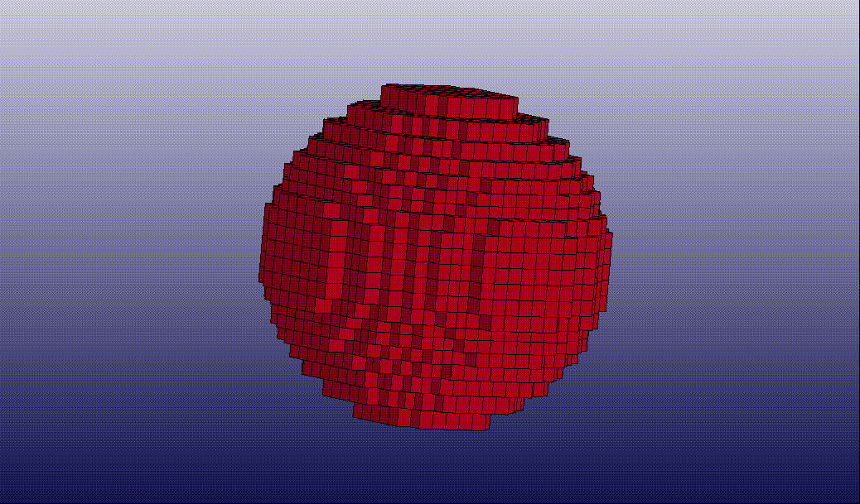
Mesh Trimming
Reduce number of S-ALE elements to save running time and memory. The following example, by trimming off elements at a distance away from the shell structures (buried inside S-ALE mesh, not shown), had a saving of 3614/9261 elements = ~40%.
http://ftp.lstc.com/anonymous/outgoing/hao/sale/models/meshtrim/saletrim.tar

Slide 3
Mesh Trimming
*ALE_STRUCTURED_MESH
MSHID | PID | NBID | EBID
1 | 1 | 200001 | 200001
CPIDX | CPIDY | CPIDZ | NID0 | LCSID
1001 | 1001 | 1001 | 1 | 234
*ALE_STRUCTURED_MESH_TRIM
MSHID | COMMAND | OPER | FLIP | NID | RADIUS
1 | SPHERE | 0 | 0 | 5 | 0.1
1 | SPHERE | 1 | 0 | 5 | 0.03
Supports 4 basic geometries PLANE, CYLINDER, BOX, SPHERE; and PARTSET, SEGSET options.
Trim or keep (OPER); Inside or outside (FLIP).
Can have multiple entries; each one processed by the order of input.

Slide 4
Mesh Trimming
Originally a box shaped mesh, trimmed by “PARTSET” option at an distance to the “LSTC” LAG structure mesh.
http://ftp.lstc.com/anonymous/outgoing/hao/sale/models/meshtrim/lstc.tar

Slide 5
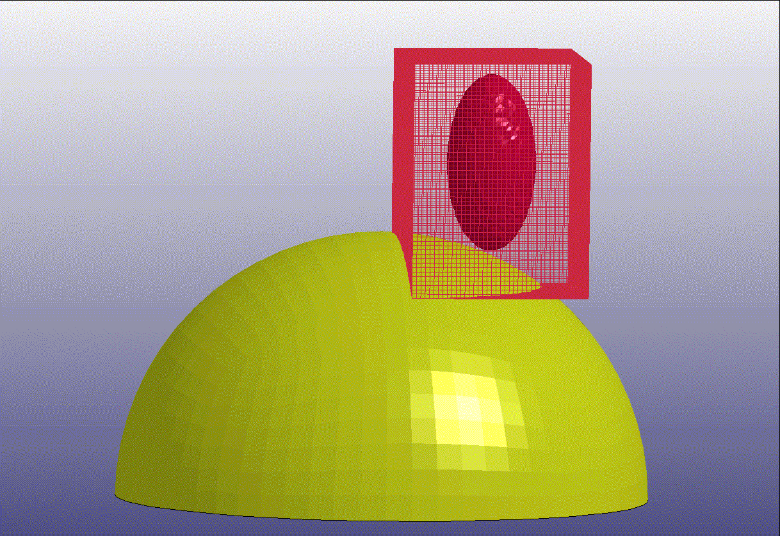
Mesh motion: FOLLOW_GC
http://ftp.lstc.com/anonymous/outgoing/hao/sale/models/meshmotion/birdstrike/bird_sale.tar

Slide 6
Mesh Motion
*ALE_STRUCTURED_MESH
MSHID | PID | NBID | EBID
1 | 910002 | 1000001 | 1000001
CPIDX | CPIDY | CPIDZ | NID0 | LCSID
1001 | 1002 | 1004 | 1000000
*ALE_STRUCTURED_MESH_MOTION
MSHID | COMMAND | AMMGSET | EXPLIM
1 | FOLLOW_GC | 1 | 2.0
There is only one option for now. FOLLOW_GC is to make the mesh move with the gravity center of certain AMMG groups; and expand/contract with those fluids.

Slide 7
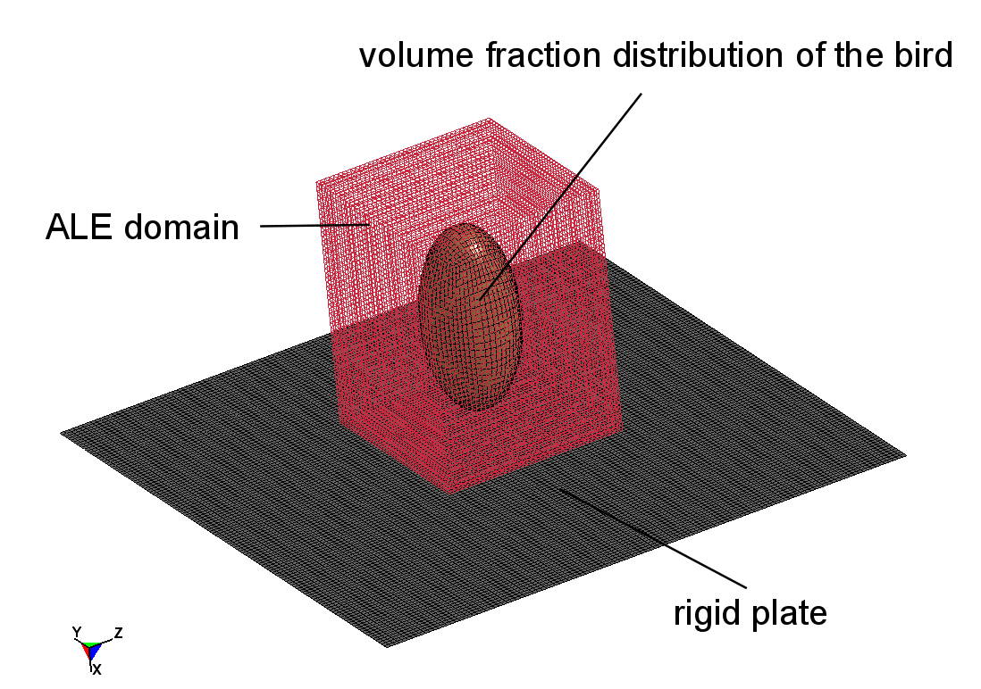
Example: Bird strike
Rigid plate 30”x30”; Ellipsoid bird, polar radius 10” , equatorial radii 5” with initial velocity 4200 in/s; ALE mesh 53x40x40 from (-21.75,-15.54,28.91) to (-8.5,-5.54,38.91)
AWG ERIF Test Case 5: Bird Strike on Rigid Plate http://awg.lstc.com/

Slide 8
S-ALE Model Setup
*ALE_STRUCTURED_MESH
MSHID | PID | NBID | EBID
1 | 910000 | 100001 | 100001
CPIDX | CPIDY | CPIDZ | NID0 | LCSID
1001 | 1002 | 1003 | 100000
*ALE_STRUCTURED_MESH_MOTION
MSHID | COMMAND | AMMGSET | EXPLIM
1 | FOLLOW_GC | 1 | 2.0
FOLLOW_GC: Follow mass center of fluid(s) and expand/contract
AMMGSET: AMMG SETID of ALE fluids to follow
EXPLIM: Expansion limit =2.0 means expand at most 2 times.
*ALE_STRUCTURED_MESH_CONTROL_POINTS
1001
1 |  | -21.75
41 |  | -8.5
*ALE_STRUCTURED_MESH_CONTROL_POINTS
1002
1 |  | -15.5366
41 |  | -5.5366
*ALE_STRUCTURED_MESH_CONTROL_POINTS
1003
1 |  | 28.9135
41 |  | 38.9135

Slide 9
S-ALE Trimmed Model Setup
*ALE_STRUCTURED_MESH
MSHID | PID | NBID | EBID
1 | 910000 | 100001 | 1000001
CPIDX | CPIDY | CPIDZ | NID0 | LCSID
1001 | 1002 | 1003 | 100000
*ALE_STRUCTURED_MESH_MOTION
MSHID | COMMAND | AMMGSET | EXPLIM
1 | FOLLOW_GC | 1 | 2.0
*ALE_STRUCTURED_MESH_TRIM
MSHID | COMMAND | OPER | FLIP | PSETID | OFFSET
1 | PARTSET |  | 1 | 910001 | 2.25
PARTSET: TRIM by reference geometry prescribed by LAG shell part set
OPER: To TRIM (0) or KEEP (1)
FLIP: To trim OUTSIDE (0) or INSIDE (1)
PSETID: PARTSET ID
OFFSET: S-ALE elements farther than 2.25 are deleted.

Slide 10
Results

Slide 11
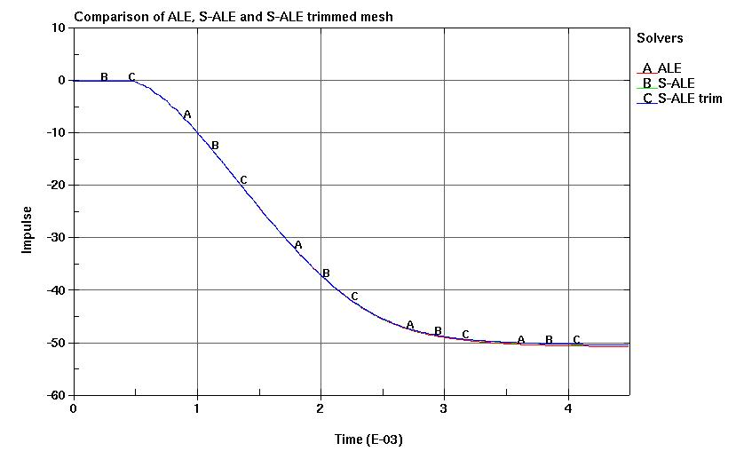
Comparison: ALE, S-ALE, S-ALE trim
METHODS | # of Elements | SMP 1 Core | SMP Savings | MPP 4 Core | MPP Savings
ALE | 84800 | 1204 s |  | 321 s
S-ALE | 84800 | 675 s | 44% | 191 s | 40%
S-ALE trim | 43219 | 426 s | 65% | 112 s | 65%

Slide 12
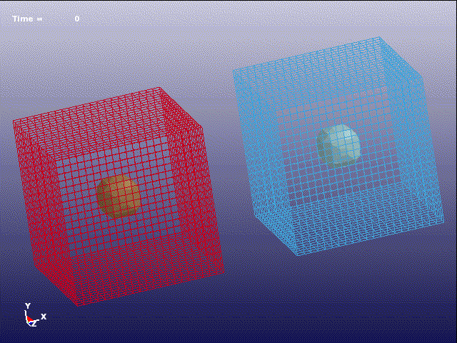
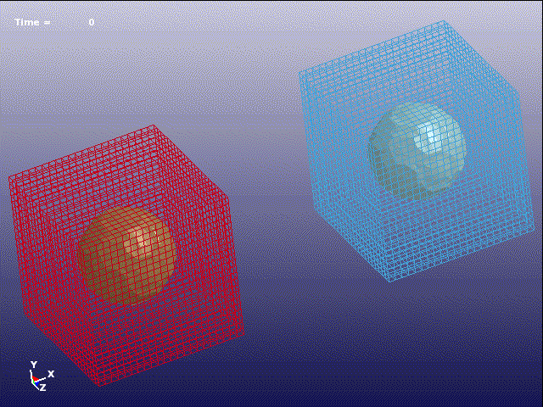
Multiple Meshes
S-ALE supports multiple meshes. By default, these meshes are independent from each other, i.e. they don’t know the existence of other meshes. These meshes can occupy different spatial domains or the SAME domain.
Contact between bags DISABLED
Contact between bags ENABLED
Two pressurized airbags, each inside an independent S-ALE mesh.

Slide 13
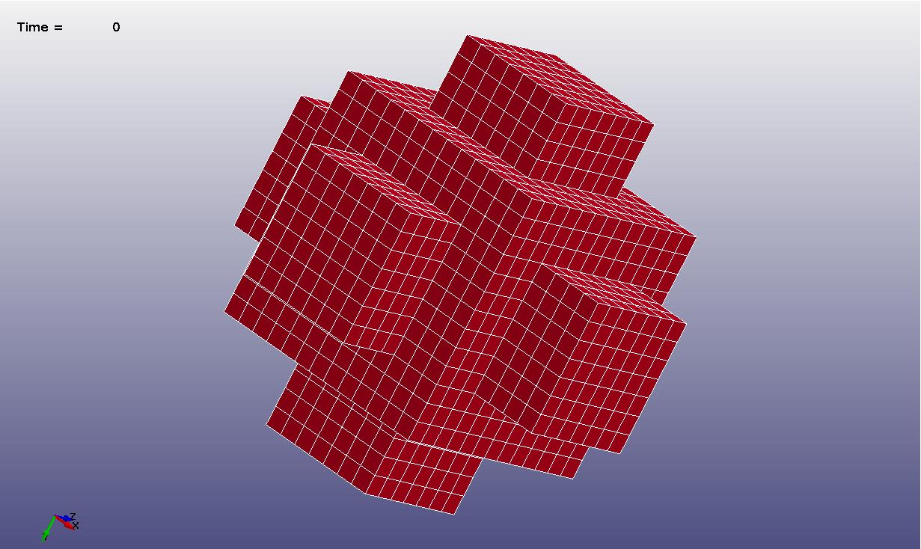
Multiple Meshes Merged
Seven meshes merge into one part.

Slide 14
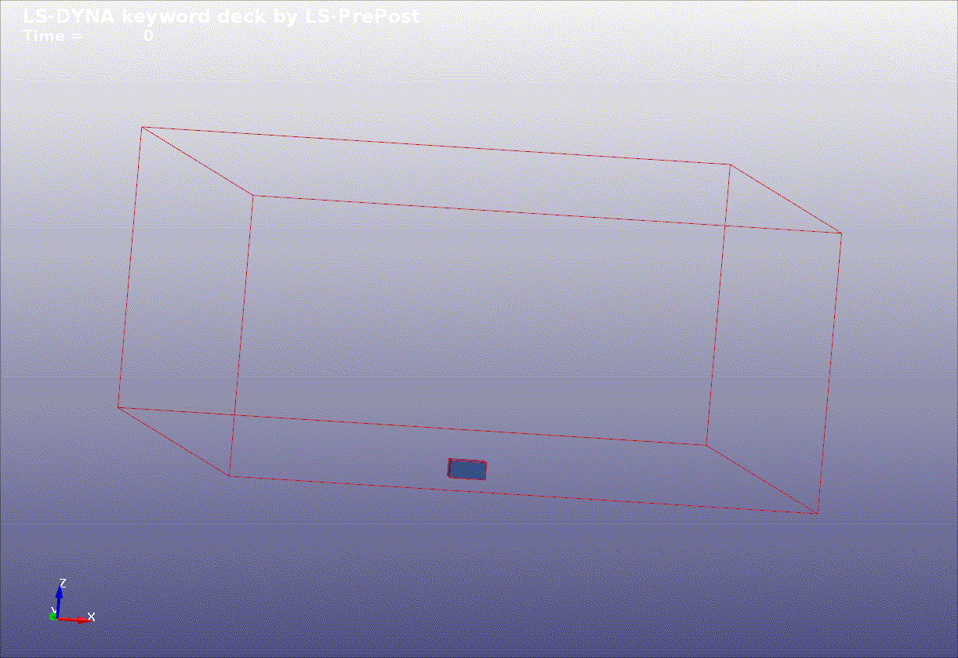
Motivation
Soil & HE needs a much smaller mesh box than air. The above two meshes setup reduced mesh usage from 6 million to 4 million.

Slide 15
Mesh Merging
Multiple *ALE_STRUCTURED_MESH cards. Different MSHID. SAME PID.
Well prepared for the future MPP load rebalancing.
*ALE_STRUCTURED_MESH
MSHID | PID | NBID | EBID
CPIDX | CPIDY | CPIDZ | NID0 | LCSID
SAME PID
*ALE_STRUCTURED_MESH
MSHID | PID | NBID | EBID
CPIDX | CPIDY | CPIDZ | NID0 | LCSID

Slide 16
Thank You

